Slide 1
Linkedin for students
Developing the product
Product Owner: Pavan Charak
© 2019 Udacity. All rights reserved.

Slide 2
Getting Started

Slide 3
Create Project Blueprint
A product launch is not just about deploying a beautifully designed,built and thoroughly tested feature. Your company needs to be equally prepared if not more to support every possible customer interaction associated with the product (e.g landing on your company website to learn more about the new feature)
© 2019 Udacity. All rights reserved.
Notes:
[ALL PARTICIPATION]

Slide 4
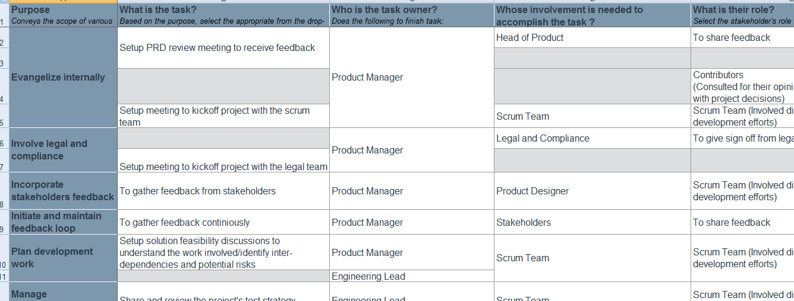
Create a coordination activities map
https://www.dropbox.com/scl/fi/liwd01kso6jj4kafn0j1g/Starter-Coordination-Activities-Map.xlsx?dl=0&rlkey=3ossma6fptsu29q3oixaicwqj
© 2019 Udacity. All rights reserved.

Slide 5
Plan for Sprint Meeting
As a PM, it is important to stay ahead of your scrum team and be prepared for every upcoming sprint by having a target goal defined with prioritized backlog for team to start costing and breaking down the tasks
© 2019 Udacity. All rights reserved.
Notes:
[ALL PARTICIPATION]

Slide 6
Sprint Planning Meeting Preparation
Sprint Goal
Enable the user to find relevant skill information for the jobs for fresh graduates.
Sprint Backlog (list the prioritized user-stories from the product backlog)
1 | As a user I want to decide my job role so that I can see the skills need be acquired.
2 | As a user I want to see the jobs in the job role selected so that I can see which skills to acquire.
3 | As a user I want to prepare my cv so that I can apply to jobs.
4 | As a user I want to see the jobs for which I am preparing so that I can be more focused.
5 | As a user I want the option to see the skills I acquired before applying to jobs so that I can see my probability.
Sprint Prioritization Logic
The feature will priortized based on their occurance in user journey map.
© 2019 Udacity. All rights reserved.

Slide 7
User Story 1
User Story | As a recent graduate ,I want to acquire skills so that to get a job.
Design | https://ciwxvs.axshare.com/
Acceptance Criteria | User click on Apply button on Jobs page. When a user has selected a job from job page. It redirects the user to skills page where relevant skills required get displayed. And user can select the skill he wants to acquire.
Assumptions | User already know about different job profiles so that he can select one of them. User is a job seeker.
© 2019 Udacity. All rights reserved.

Slide 8
User Story 2
User Story | As a recent graduate, I want to connect to people aspiring for similar job roles so that I can see their progress
Design | https://ciwxvs.axshare.com/
Acceptance Criteria | A user is on auto connection page where he wants to connect with people aspiring for similar job roles. On selecting the auto connections box All people acquiring similar skills gets displayed And user can choose the other users he wants to connect to.
Assumptpiring ions | We have enough data points of other user to show progress.
© 2019 Udacity. All rights reserved.
Notes:
other

Slide 9
Decoding API Documentation
As a PM, you will collaborate with the engineering team and provide guidance that heavily influences their development approach. When a product requires an API integration, sometimes PM need to be “technical enough” to understand the following to refine the solution with designer and development team
what information is available via the API
how is it available
possible pricing impact
© 2019 Udacity. All rights reserved.
Notes:
[ALL PARTICIPATION]

Slide 10
Linkedin for students Project
Based on the API documentation how would you update your solution and design? | 1. We ensure that career journey of different job profiles from LinkedIn should be visible for graduates .
Based on your high-level understanding of the API documentation, are there any details that you want to discuss with engineering to refine solution and/or determine feasibility | How complex is to make seamless integration of job posting between two apps ? Can you quantify the story points required to display the content from professionals having similar roles ?

Slide 11
Re-prioritize Sprint Backlog
As a PM, unexpected issues and new feature requests will require you to triage them efficiently and re-prioritize the sprint backlog without impacting the roadmap deliverables significantly
© 2019 Udacity. All rights reserved.
Notes:
[ALL PARTICIPATION]

Slide 12
Issue 1: Landing Page loading too slow
Determine impact and criticality to prioritize issue | Is there any change in trend in last 5 days as far as drop off from landing page is concerned. Has the performance of ongoing campaigns have negatively impacted in last 5 days. Has the % conversion dropped in last 5 days. If the answer to any of the first 3 questions is yes, then we have urgently raise a critical issue and push into as top most item in next sprint.
Next Steps You would carry out typically using JIRA (ticketing tool), communication channel (Slack) | We need to raise a bug in jira tool with issue priority as critical. We need to ensure the bug is assigned to QA team. We need to inform the customer team to get ready for the complains regarding this issue.
Would you take additional steps ? | On raising the severity, all the impacted stakeholders will be informed about the corrective actions taken.
© 2019 Udacity. All rights reserved.

Slide 13
Issue 2: Misaligned fields in Profile Settings
Determine impact and criticality to prioritize issue | Knowing the frequency of occurrence of the issue along with quantification of impact on new users would be important ? Quantifying the effort required to fix the issue would help to pipeline the hot fix ? If the impacted users is less than 2% and frequency of occurrence is also low, we can downgrade the priority to 3.
Next Steps use ticketing tool (JIRA), and communication channel (Slack) | As we have downgraded the priority, we will use Jira and slack to communicate to rest of stakeholders. As It is a low priority item, we will add it to the product backlog .
© 2019 Udacity. All rights reserved.

Slide 14
Respond to Customer Service Manager’s Email
Determine impact and criticality to prioritize the issue (1 - Critical; 2 - High; 3 - Normal; 4 - Low) | What is causing the issue to occur and is it happening with all users or with specific ones ? Can we quantify the amount of effort required to get the hot fix for the issue. As the no of users impacted are huge and they are not able to access the full product . Severity is rasised to 1.
Next Steps You would carry out typically using JIRA (ticketing tool), communication channel (Slack) | We will inform the relevant stakeholders through slack and raise th severity to 1. Scrum team will be aliggned for the unplanned sprint to install the hot fix for the issue.
Sample Email Response | Issue has been acknowledged and relevant stakeholders have been informed about the high severity of issue. Root cause and possible solution has been identified. The Scrum team is already preparing for the hot fix in the upcoming sprint. However mean time we are expecting the call volume to increase hence proper resource allocation has to be there to support this situation.
© 2019 Udacity. All rights reserved.

Slide 15
Handle Potentially Difficult Situations
As a PM, you will be faced with many unexpected situations where you have to make a decision or push back while managing competing priorities from stakeholders and tackling issues that could potentially affect your product launch
© 2019 Udacity. All rights reserved.
Notes:
[ALL PARTICIPATION]

Slide 16
Respond to CEO or GM’s request via email
Assessment and result | How much more time we require to get the code deployed in staging environment and with stability ? Can you share the status of code running in QA time ? Are we on track to deploy the code in production on time ?
Sample Email Response | We are on track as far as deployment of code in production is concerned. However currently the developers are deploying the code in QA environment and thereafter they will be able to staging environment. Hence in 2 days time , all the features will not be available for demo. However our core features are already deployed and tested and we can demonstrate them during demo day.
© 2019 Udacity. All rights reserved.

Slide 17
Step-in and guide the scrum team at stand up
Video Response | Share the link to your video here https://www.dropbox.com/s/szrtz8inax8mpar/20210211_124909.mp4?dl=0 There are 2 tickets in the code review status with back end team and that has dependcy on 2 front end tickets which are already ready to test. Moreover there is also an analytics ticket whose development has to start today to avoid making it launch blocker. In order to reduce the effort we have downgrad ][[][[ed 2 out 5 tracking requirements to nice to have requirements. However in order to complete the sprint on time , we have to complete the pending tasks on time. In case there is any blocker do let me know.
© 2019 Udacity. All rights reserved.

Slide 18
Handling Resource Constraints
List 2- 3 activities that you would carry out as a PM to unblock the scrum team immediately ? | We will take into consideration quantum of work pending owing to absence of QA member. We will get in discussion with other PMs to understand the criticality of stage ?
Since the QA team member is shared across multiple projects, how would you coordinate with other PMs to de-risk your project and raise appropriate visibility ? | Since this feature requires API integreation that involves multiple sprints. Story points required for the pending QA are in early one digit hence anyways it will not impact the bandwidth available to QA member. Since we are developing the core functionality ,it will help in stablishing the product and has positive impact on other PMs job.
Since there is a potential risk, it is important to raise visibility amongst appropriate stakeholders | Director Product Management Senior Product Manager
 | Communication would be more focus on making other PMs release the importance of completion of sprint on time.
© 2019 Udacity. All rights reserved.

Slide 19
How would you handle stakeholder feedback?
Feedback Assessment | Why do you think it is important for us to daily notifications regarding usage of feature ? Do you think we have not exhaustively covered customer journeys ? Do you really believe the usage of app will drop significantly if we don’t send the push notifications?
Video Response | Share the link to your video here https://www.dropbox.com/s/7274n2bf5nn3w6k/20210211_125712.mp4?dl=0
© 2019 Udacity. All rights reserved.

